Slide 1
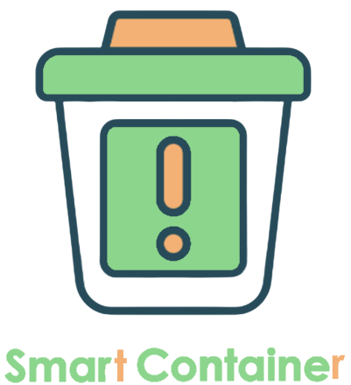


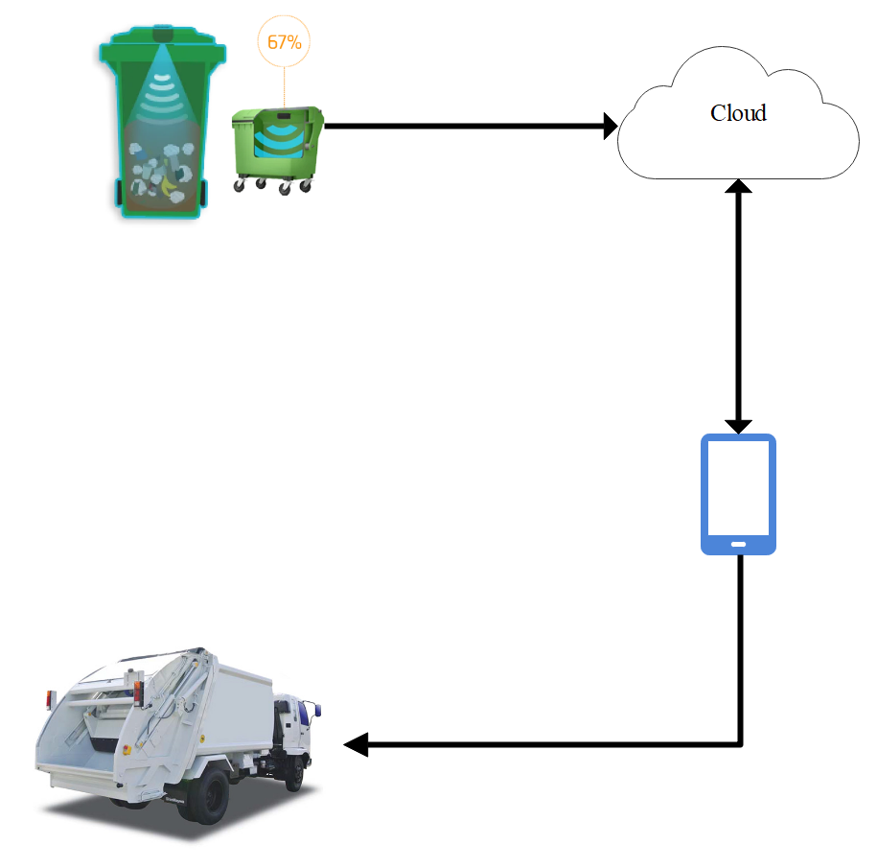
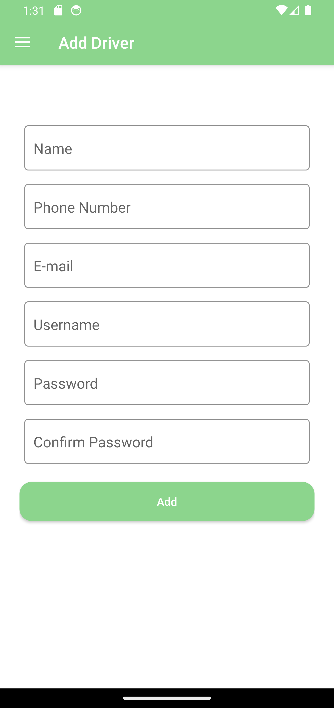
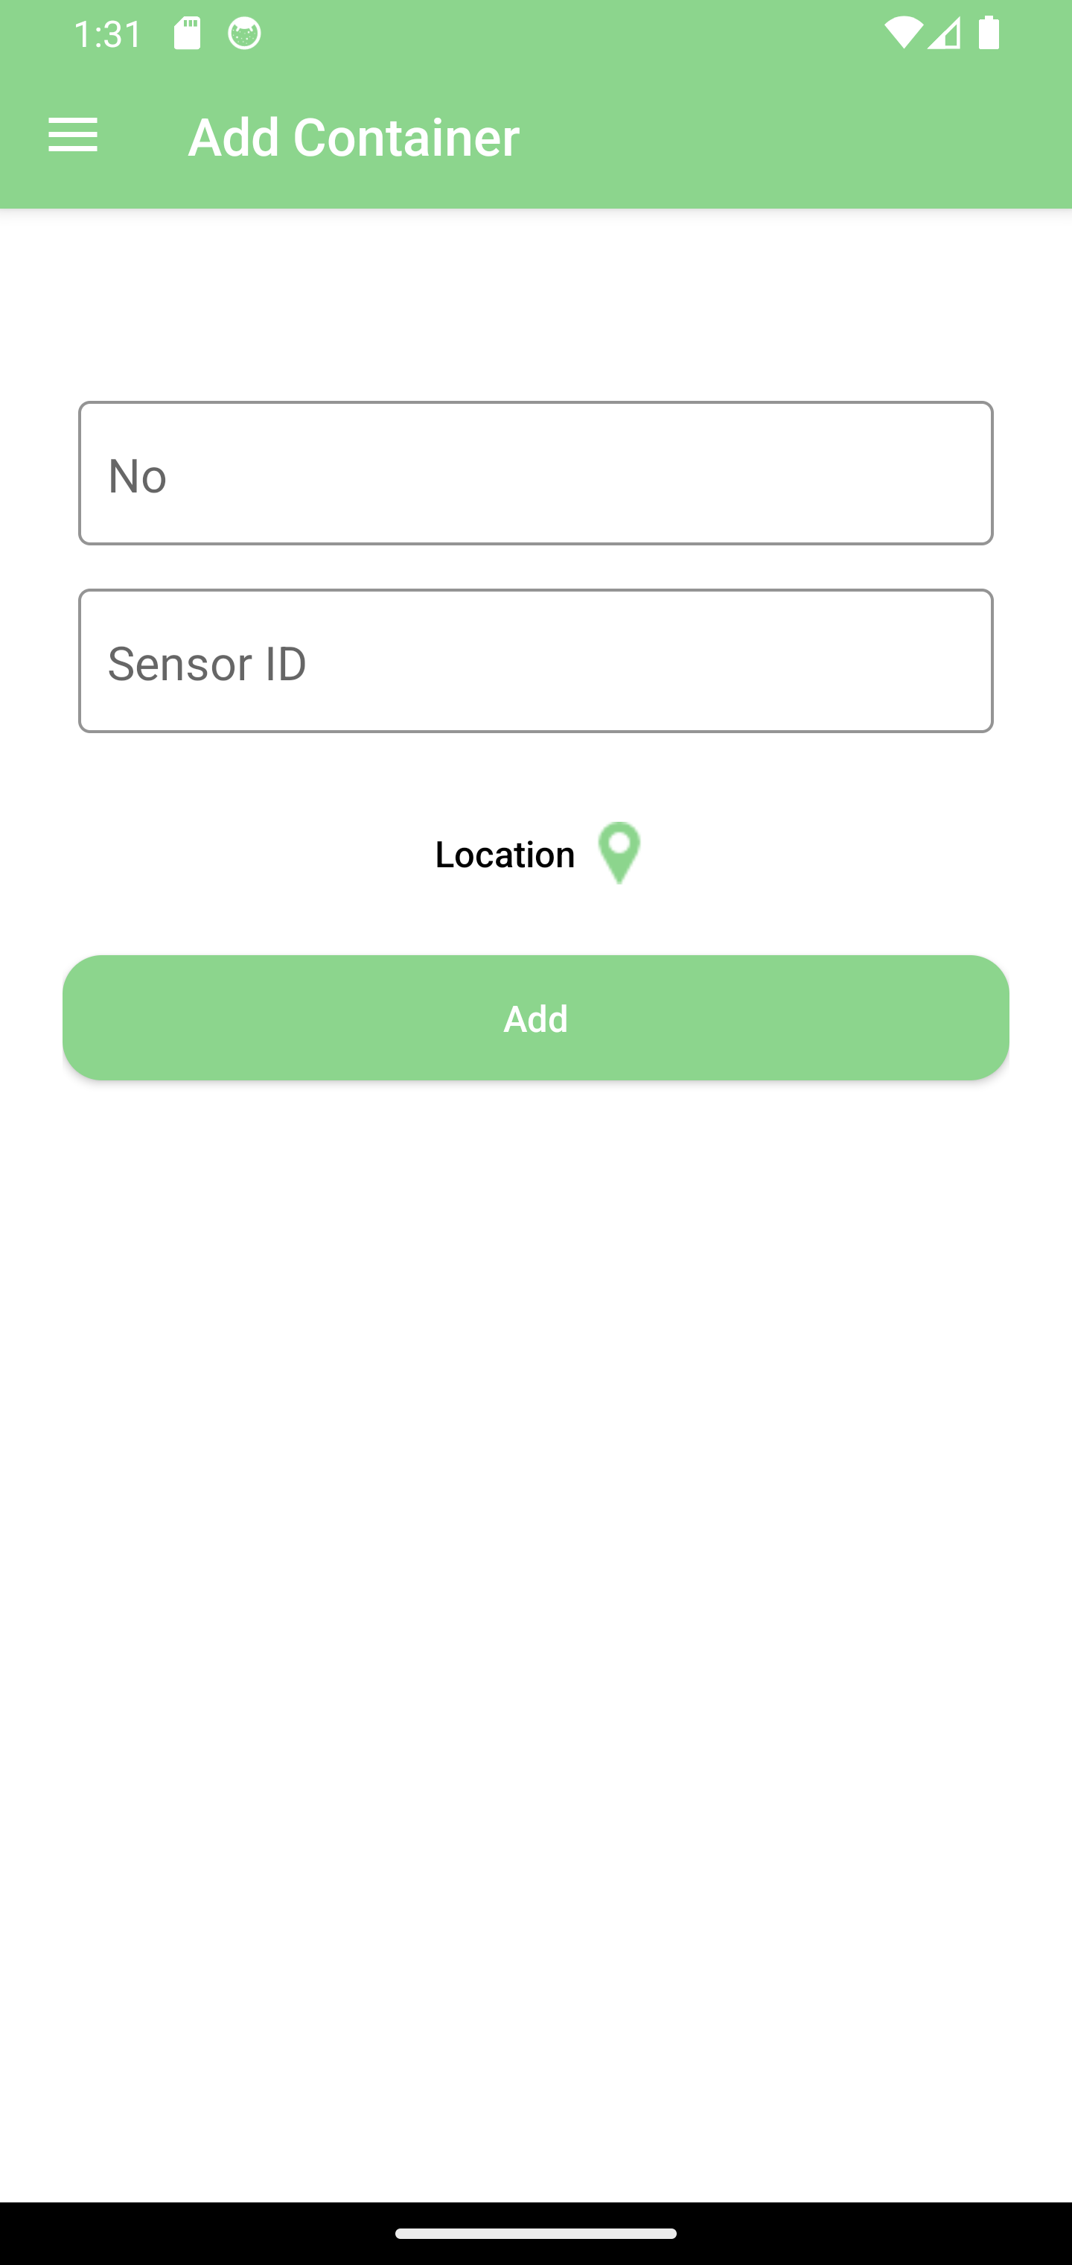
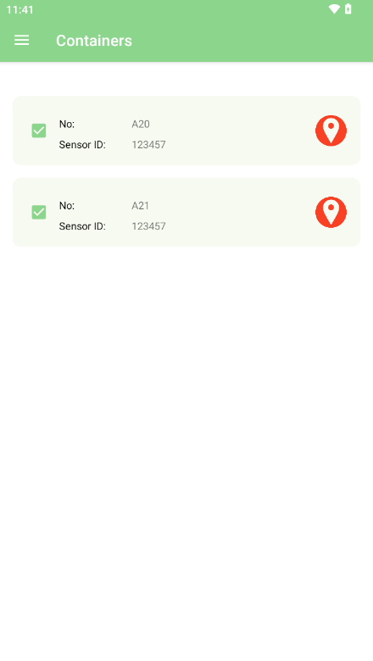
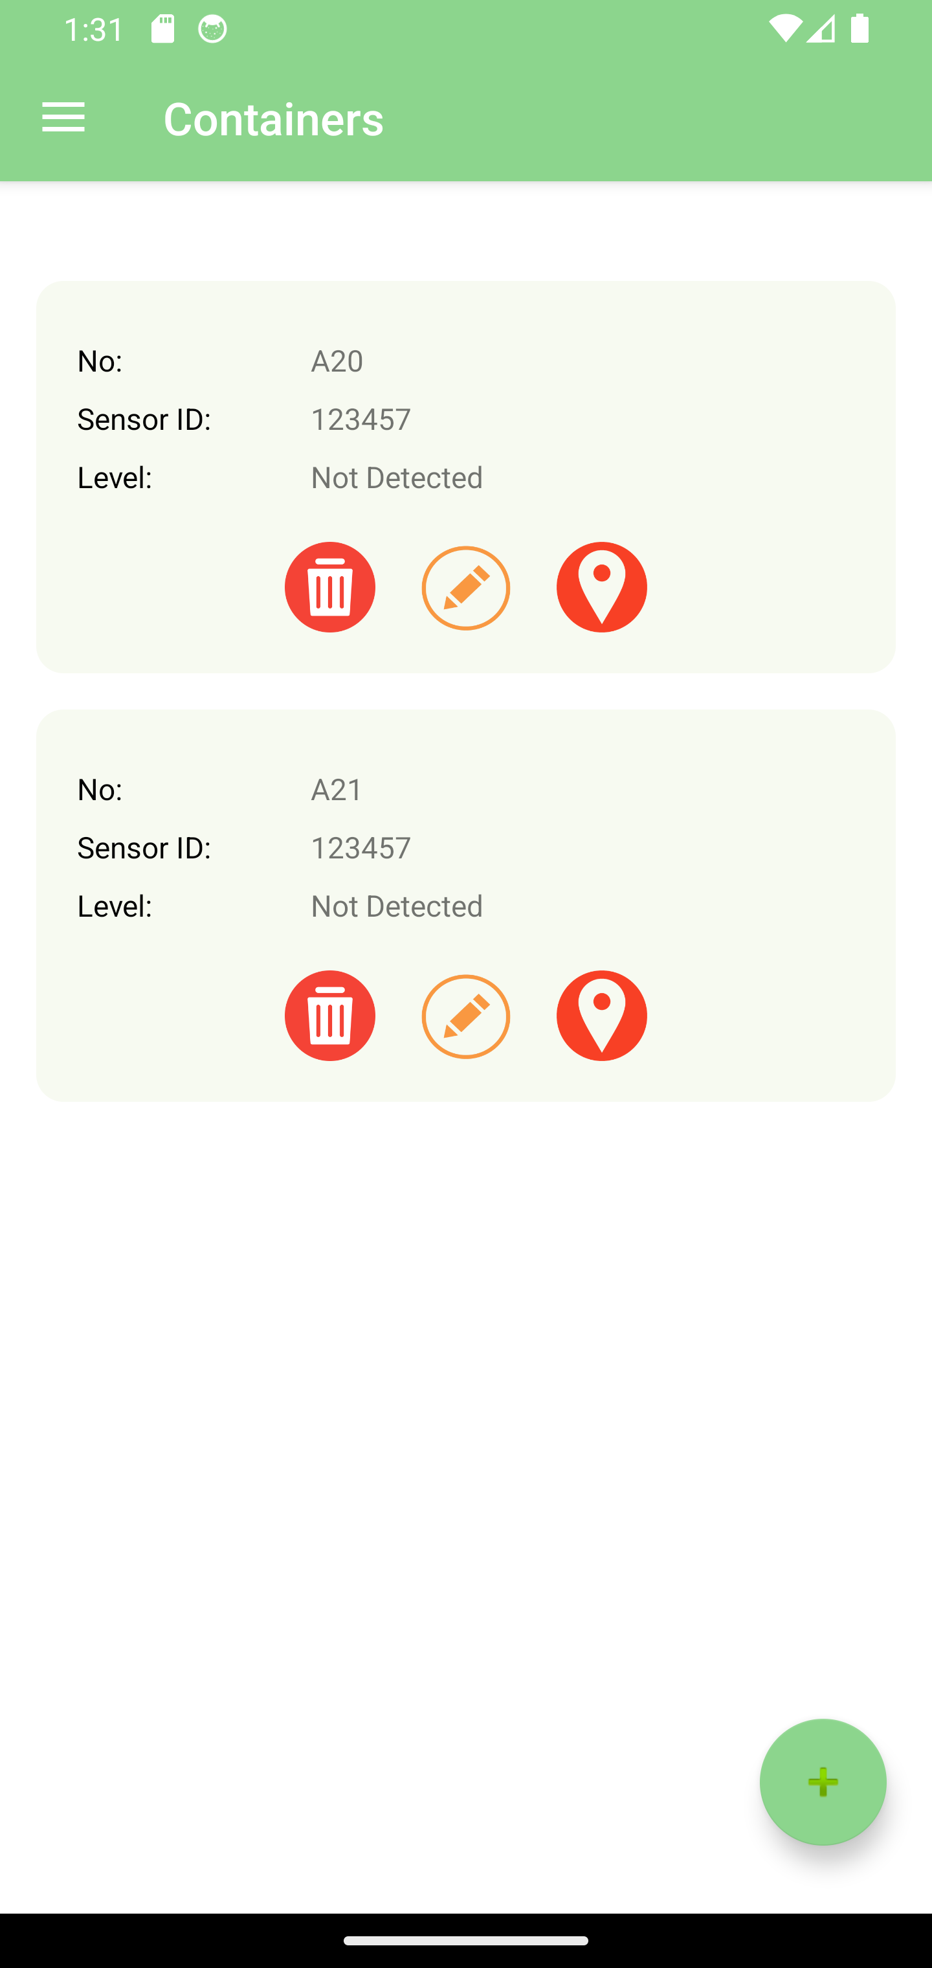
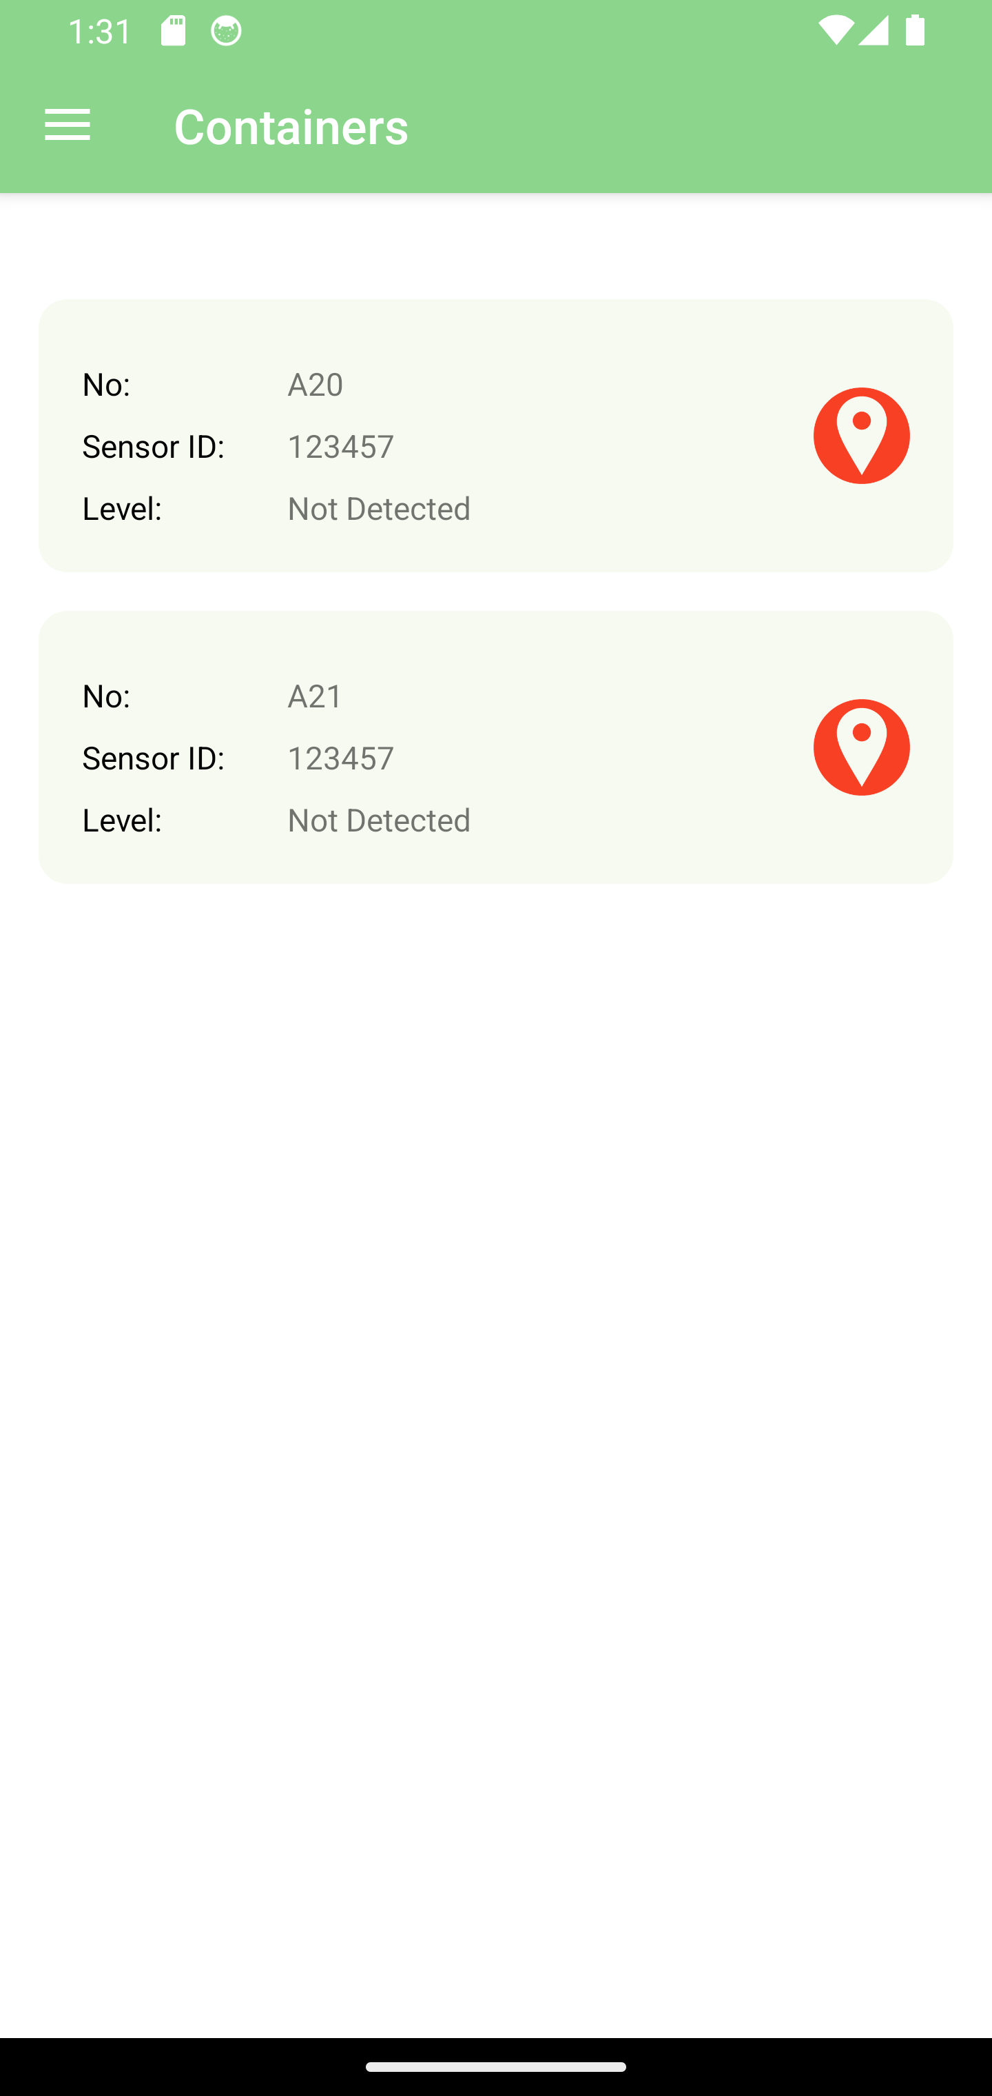
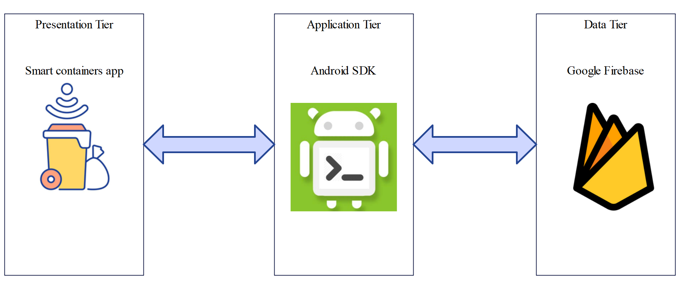

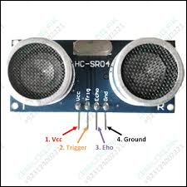
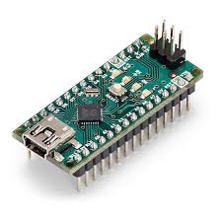
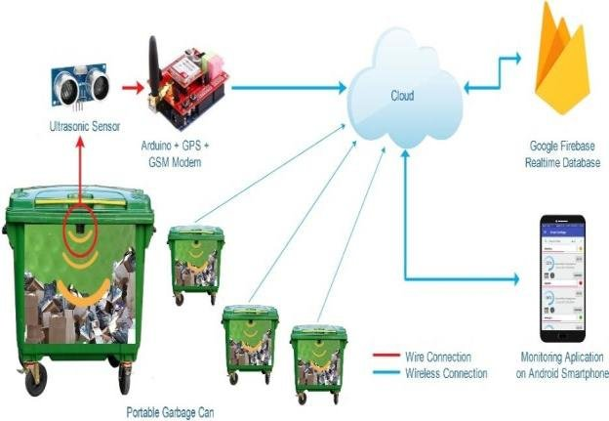
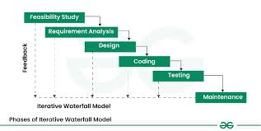
Smart Waste Container
Participants:
Adel Masad, Hussien ali, Waddah Nafea, Abdulaziz Naji, Waleed Abdullah
Ahmad Abdulrhman, Ahmad Abdulrhman
Project ID:1 Supervisor: Dr. AbdulHadi Al-Ahmadi
University of Taibah – Department Computer Science
Introduction
Results
Today, we are experiencing a technological revolution in various areas of life, especially in the field of communications and the Internet. Technology has created amazing tools and resources, putting useful information at their fingertips.
Information systems have entered many fields of life: education, health, training, economy, entertainment, and others. The use of information systems has become indicative of the quality and prosperity of work in all fields.
The Kingdom of Saudi Arabia has been a pioneer in the field of computing and the use of the Internet, as many sectors have been computerized, and many services have been provided in the public and private sectors via the Internet.
Sustainability is the study of how natural systems function and produce everything the natural environment needs to remain in balance. Sustainability aims to preserve the available resources for life to ensure the continuation of life for future generations.
Figures issued by the National Center for Waste Management indicate that the volume of waste in the Kingdom is 53 million tons, and the economic cost of the current management of municipal waste is about 3.5 billion riyals
Sustainability is among the pillars of the Kingdom of Saudi Arabia's Vision 2030 to provide a better life for citizens and future generations, so the government of Kingdom of Saudi Arabia's launched many initiatives aimed at protecting the environment and reducing the emission of harmful gases resulting from burning petroleum derivatives.
In this project, we will employ smartphone and IOT technology to support the sustainability process in the Kingdom of Saudi Arabia by developing a smartphone application that helps in reducing the negative environmental impact associated with the waste collection process in cities in the Kingdom of Saudi Arabia.
The proposed project will be implemented as a mobile application for smartphones that run Android operating system and Arduino KIT, the application will view the level of the waste in the containers, the this enables the compactor driver to collect waste from full.
This will help save time and effort on the waste compactor driver and cleaners, in addition to reducing the emission of harmful gases to the environment due to the burning of petroleum derivatives on which the waste compactor operates.
This system will be developed as a smartphone application to assist in the process of collection waste in Sudi Arabia cities.
Conclusion
Objectives
In conclusion, the "Smart Waste Container" project is a significant contribution to supporting sustainability and achieving the vision of Saudi Arabia 2030. By utilizing Internet of Things technology and smartphone applications, waste collection is efficiently enabled, and waste management is improved.
The smart container technology allows drivers to monitor waste levels in real-time, making it easier for workers to identify containers that need emptying and avoid overflowing. As a result, time and effort are saved in the waste collection process.
It can be said that the "Smart Waste Container" project supports sustainability goals and the transition towards a healthier and cleaner future. It promotes the use of technology in waste management and improves waste collection processes, while contributing to the conservation of natural resources and the preservation of the environment for future generations.
In the attached image (Figure 1-1) , a waste management project is shown that uses a container equipped with an Ultrasonic sensor and an Arduino chip. The sensor is used to measure the level of waste in the container and send this data to the cloud database. Through the database, the application can receive this data and display it to the driver on the mobile. If the waste level reaches 80%, the driver will go to the container location to unload the waste.
The proposed project aims to achieve the following objectives:
1. Developing a smart waste container based on Internet of Things technology.
2. Save time and effort of waste compactor driver and cleaners.
3. Reducing the emission of harmful gases from waste compactors.
4. Save money by reducing fuel consumption.
5. Help in achieving the sustainability goals of Vision 2030.
6.The proposed application will be implemented in the Arabic language.
Methodology
ultrasonic sensor
Arduino UNO KIT
In software engineering, the Systems Development Life Cycle (SDLC) is a process of creating or altering information systems, (SDLC) adheres to critical phases for developers; they are planning, analysis, design, implementation, and maintenance , SDLC aims to produce high-quality software that meets or exceeds customer expectations and reaches completion within time and cost estimates.
There are many software methodologies, like Waterfall , Waterfall one of the simplest and fastest methodologies, it is a sequential design process, used in software development processes, that mean it is not an-iterative process.
Waterfall is suitable for this project because project requirements are clear from the beginning of the development process, therefore there will be no big modifications and changes in the system requirements.
Figure 1-1 Smart waste container
References
"Saudi Arabia Ranks 5th Worldwide, in Terms of Mobile Internet's Speed," 18-5-2021. [Online]. Available: https://english.mubasher.info/news/3808774. [Accessed 15-9-2023]
"Smart sustainable cities," International Telecommunication Union, 1-12-2021. [Online]. Available: https://www.itu.int/en/mediacentre/backgrounders/Pages/smart-sustainable-cities.aspx. [Accessed 3-10-2023]
Alyaum, "Volume of waste in the Kingdom," Alyaum, 26-2-2022
A. S. Gillis, "Systems development life cycle," Tech Target, 1-6-2019. [Online]. Available: https://www.techtarget.com/searchsoftwarequality/definition/systems-development-life-cycle. [Accessed 2-10-2023]
Acknowledgements
First, we are grateful to Allah Almighty for his countless blessings and courage given to complete this graduation Project. A project report usually falls short of its expectations until and unless guided by the right people at the right time. Hence, we would like to express our deep sense of gratitude and heartfelt thanks to our project supervisor for his support, encouragement, and motivation during project work. We would also like to thank our classmates for their cooperation and competition which helps us to stand in academic race. Special thanks to our parents for giving us confidence, love and guidance which worked as accelerator for us.
Thanking Everyone.

